Slide 1
Moon Night Hotel Profile
Group 5
- Fia Valentina Setiono
- Gendis Putri Ayu Larasati
2WD2

Slide 2
Html
HTML (stands for Hypertext Markup Language) is a computer language that makes up most web pages and online applications. A hypertext is a text that is used to reference other pieces of text, while a markup language is a series of markings that tells web servers the style and structure of a document.
The average website includes several different HTML pages. For instance, a home page, an about page, and a contact page would all have separate HTML files.
The three main parts of an element are:
Opening tag – used to state where an element starts to take effect. The tag is wrapped with opening and closing angle brackets. For example, use the start tag <p> to create a paragraph.
Content – this is the output that other users see.
Closing tag – the same as the opening tag, but with a forward slash before the element name. For example, </p> to end a paragraph.

Slide 3
CSS
Cascading Style Sheets (CSS) is a stylesheet language used to describe the presentation of a document written in HTML or XML (including XML dialects such as SVG, MathML or XHTML). CSS describes how elements should be rendered on screen, on paper, in speech, or on other media.
Vintage style!

Slide 4
Introduction
In our 3rd project, we created a simple website entitled "Moon Night Hotel". This website is the same as other hotel websites, the Moon Night Hotel website has a lot of content about hotels in it. There is a choice of Home, various types of Rooms, types of Food and Drink, Weddings (info about the building, decor references, and package prices) , Offers contains numbers or contacts that can be contacted to order, Location, and the Booking Now Form. When the booking form is filled in, at the end you will see the input amount of the order.

Slide 5
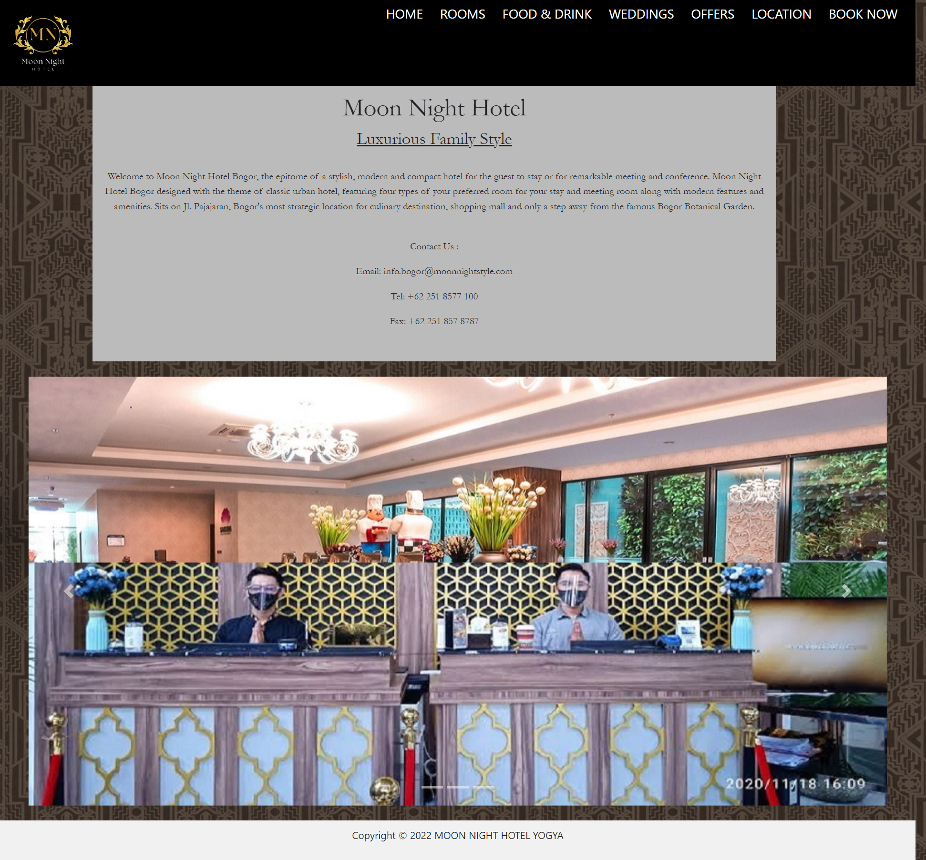
Html Pages
Home
Pages
Remember the moments

Slide 6
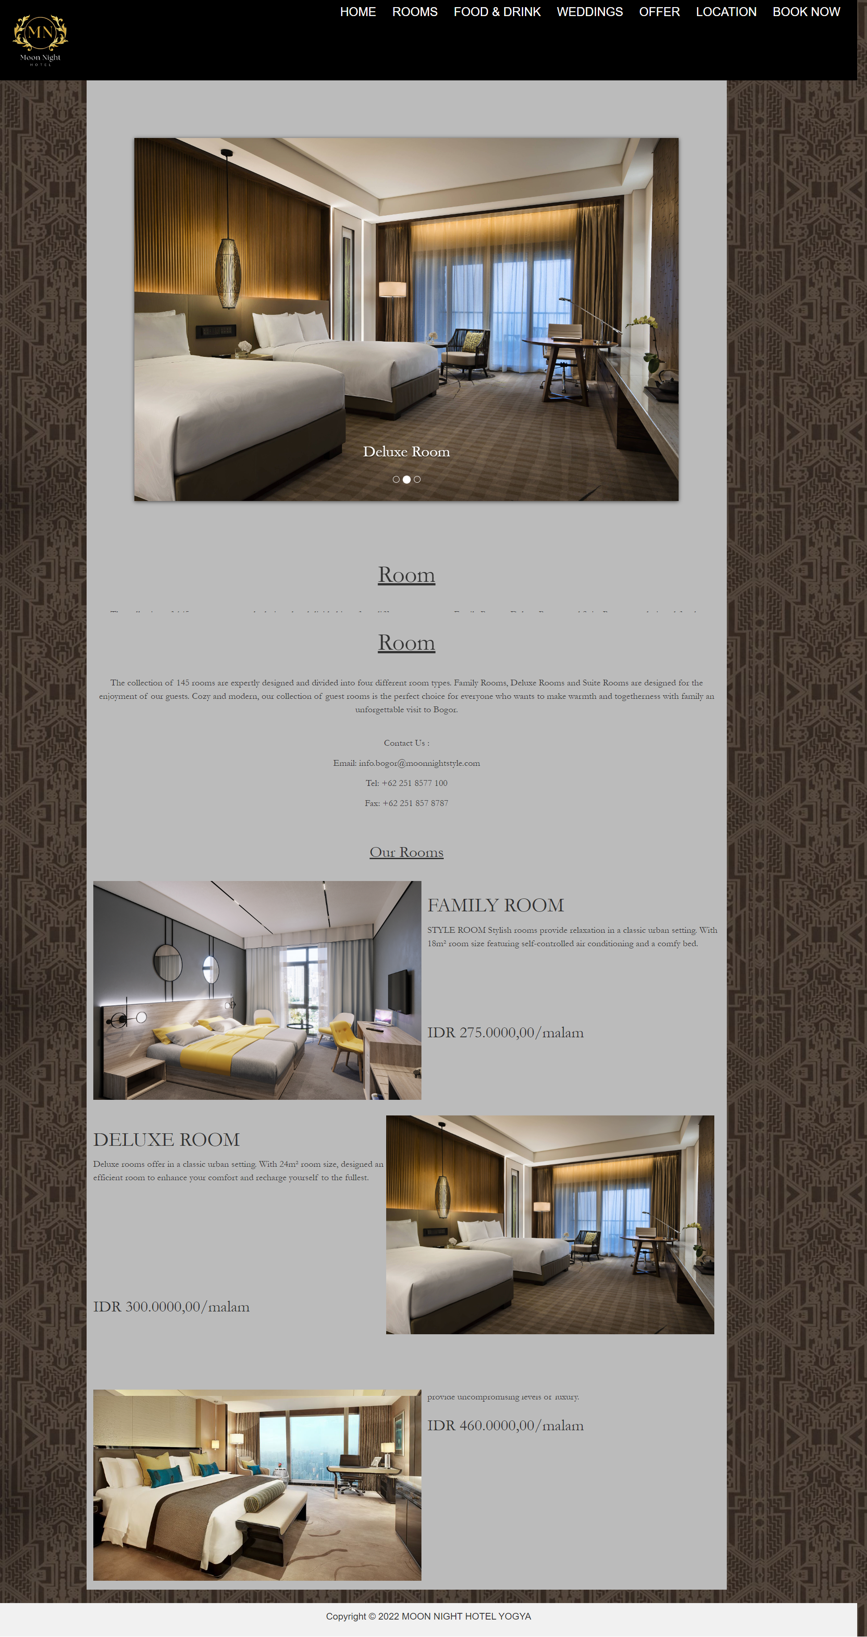
Html Pages
My Goals
Rooms
Pages

Slide 7
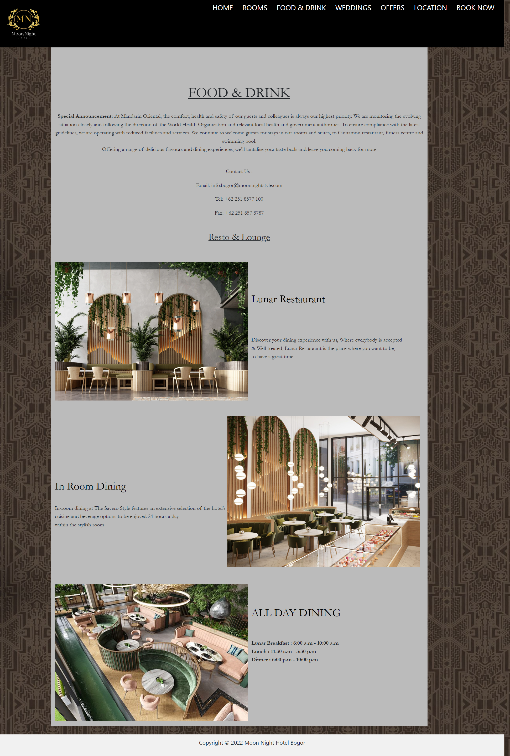
Html Pages
Food & Drink Pages
Remember the moments

Slide 8
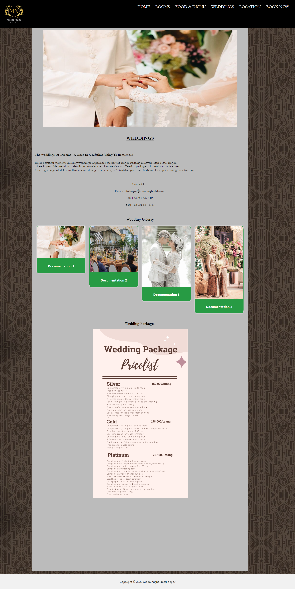
Html Pages
My Goals
Wedding
Pages

Slide 9
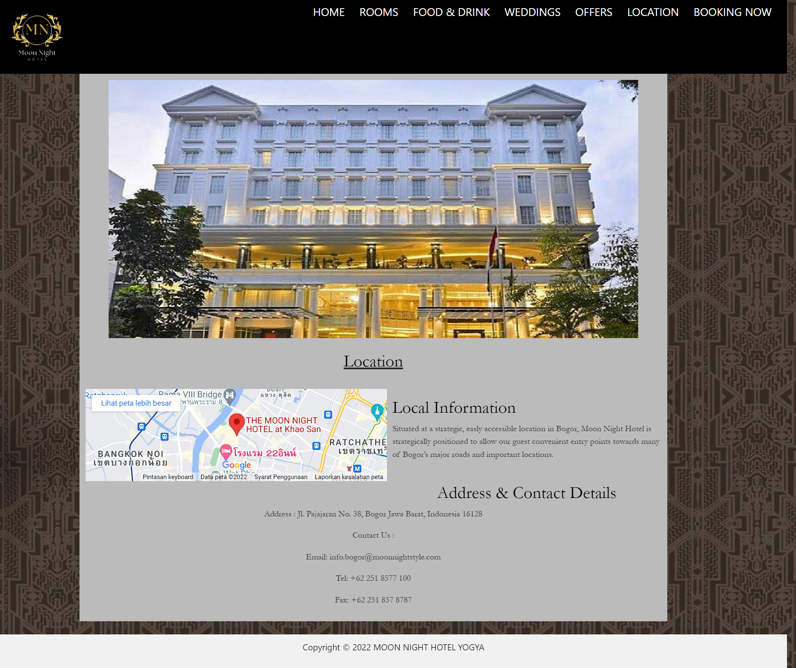
Html Pages
Location Pages
Remember the moments

Slide 10
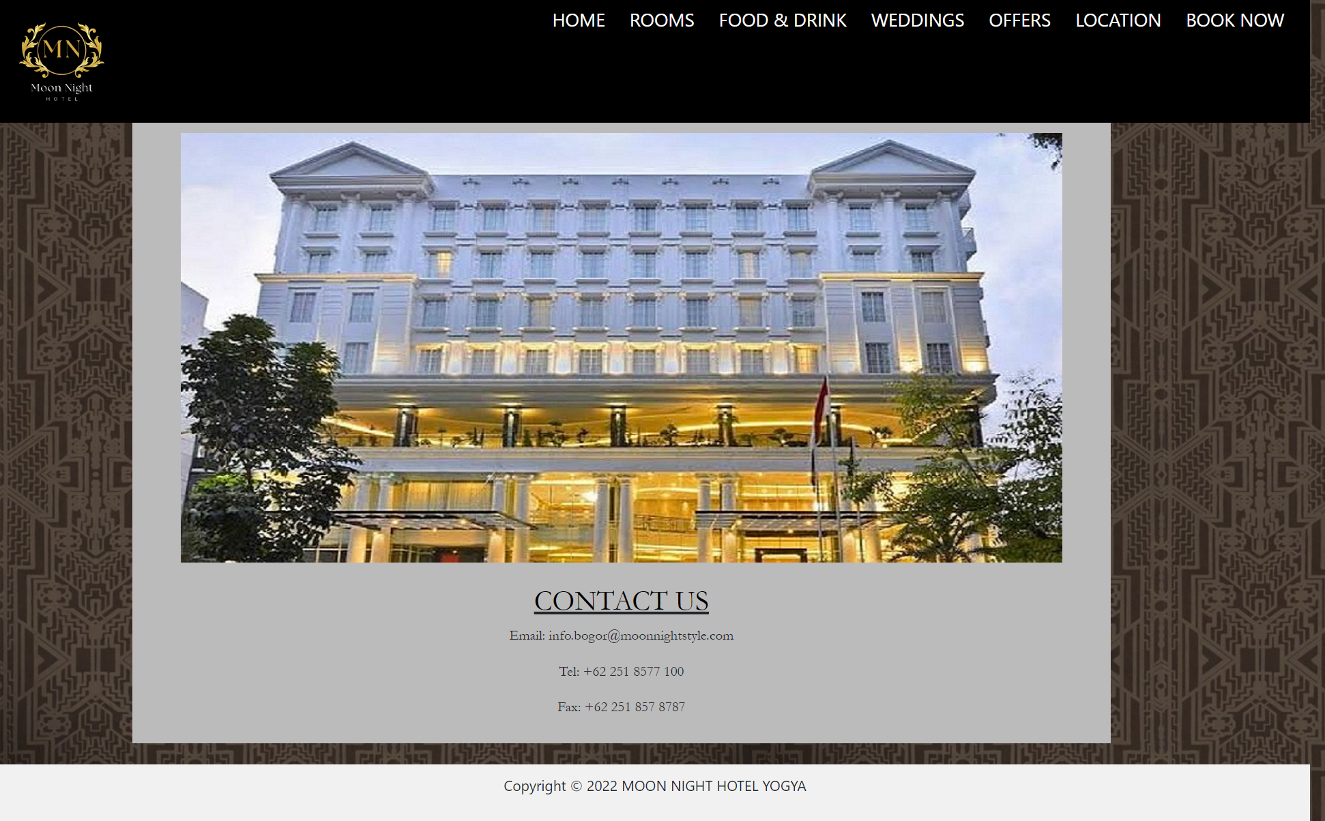
Html Pages
My Goals
Offers Pages

Slide 11
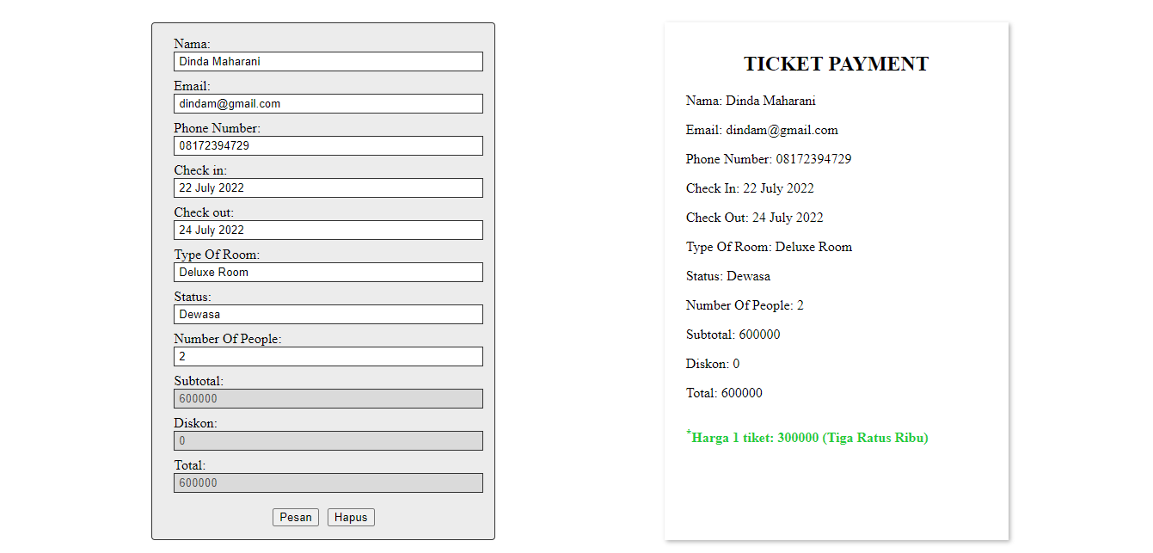
Html Pages
Booking Pages
Remember the moments

Slide 12
Thankyou

